Slide 1
Cable Tagging Process Improvement
DMAIC

Slide 2
Problem Definition
Problem:
use of stores inventory stickers and identification for tagging cables
which is non-conforming to industry practice
long process of finding cable application information
Cause: lack of standardization for cable tags and labels for the respective terminating devices
Impact :
cable mix up during assembly, repairs and maintenance leading to more downtime/delays in completing tasks
risks such as short circuit due to interchanged cables.
Hectic quality check process as cables have to be traced manually to there origin.
aesthetically it doesn't give a good impression to both internal and external persons of interest

Slide 3
Industry Practices
THE ANSI TIA/EIA CABLE LABELING STANDARDS
The standards that are used here are designed to make it easy to implement, and useful for anyone who is working with the cabling in the future. There are a number of underlying principles that were used to create the standards which includes:
Consistent - Any company that uses these standards needs to make sure they are followed throughout all areas of application. Consistency helps to ensure that everyone who works on the cabling will be able to understand the labels at all times.
Identify Physical terminations - The labels need to identify where the cables are going to. and where from.
Easy to Read - Labels need to be printed on high quality label stock, and with a good printer, to help ensure the text on them is easy to read.
Durable - The print stock used should be made to last long periods of time. The cables often last for many years, and the labels should last just as long. This applies both to the physical label, and the print on it, which should not fade.
Universal Agreement - All departments and team members throughout a company need to agree to follow these standards or it will only create additional confusion.
Pervasive - All cables should be labeled at both ends to ensure anyone who comes to use them will be able to get the information they need about these wires.

Slide 4
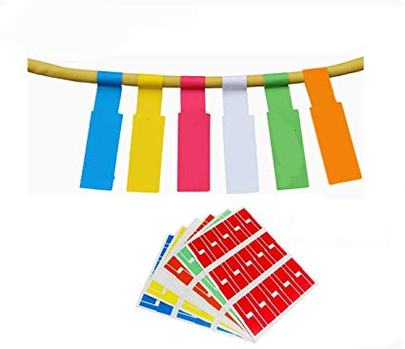
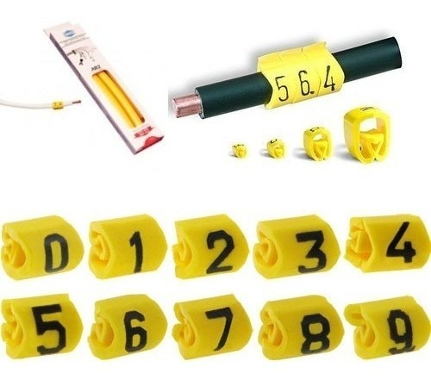
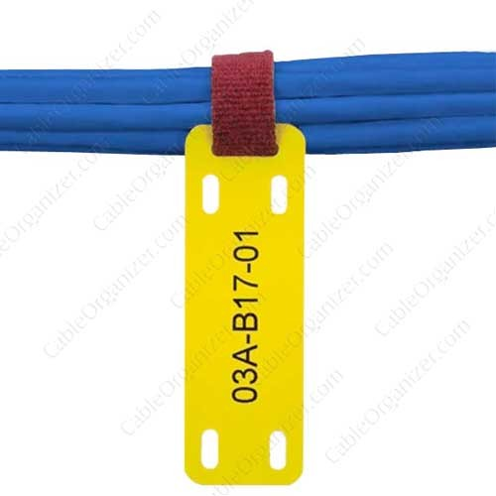
Project Proposal
The objective of this proposal is to establish a standardized method to label terminating components and tagging cables
the illustration below is an example of how to create a cable tag that can represent one,both or all of these function,termination ports and characteristics
K2-N
NFC
UPS
U-K1
KPC
K3-C
canister full
The above illustration shows termination points for three cables U-K1, N-K2 and C-K3 in which case K1,K2,K3 represent different ports on the kokopoint controller. U,N and C represents the field devices connecting to the controller.it is the actually the simplest form of tagging/labelling which indicates distinctive termination points for the named cables.
There exists several options for cable tagging which includes plastic tags,paper tags and cable engraving.For our case i would recommend plastic tags and paper tags depending on if a cable is bought ready or sub assembled within.below are sample options to choose from and any other not mentioned in this project. I believe this will contribute wholesomely towards being a world class manufacturing company.

Slide 5
Cost for current printed stickers
Outsourced Print | Sticker Needed | Serialised Parts / Subassemblies QTY | Cost Per sticker | Total Cost
KP Serialisation Labelling Cost for KPR tracking | Serial no | 15*800 | $0.05 | $600
KP Serialisation Labelling Cost for KA tracking | Serial no | 15*800 | $0.05 | $600
 |  |  | Total | $1,200

Slide 6
Cost for cable tags
 | Cost Per Unit/Roll (Contains 1000 Pieces of the same letter) | Quantity needed 26 alphabets + 10 numerical digits | Cost Per Cable | Cost For 800 Cables
Plastic tags ( Preprinted letters and numbers) | $ 0.89 | 36 | $ 0.00267*15*800 | $768
PET and thermal paper tags | US$ 2.80

Slide 7
Expected Outcome
Permanent - The labels should be permanently placed onto the cables.
Identified at Both Ends - Both ends of the cables need to be labeled.
Termination Points Identified - The termination points need to be identified on the labels.
Legible - Labels need to be legible, which typically means they should be printed off rather than hand written.
Match with Records - Information on the labels should be recorded into records. This allows technicians to get additional information as it is needed.

Slide 8
e.nyaranga@kokonetworks.com
SUB ASSEMBLY TECHNICIAN

